Slide 1

Better timer experience
By Daniil melezhyk

Slide 2
All improvements sources
New ficures
Design based on internet users interests
Users behave studies

Slide 3
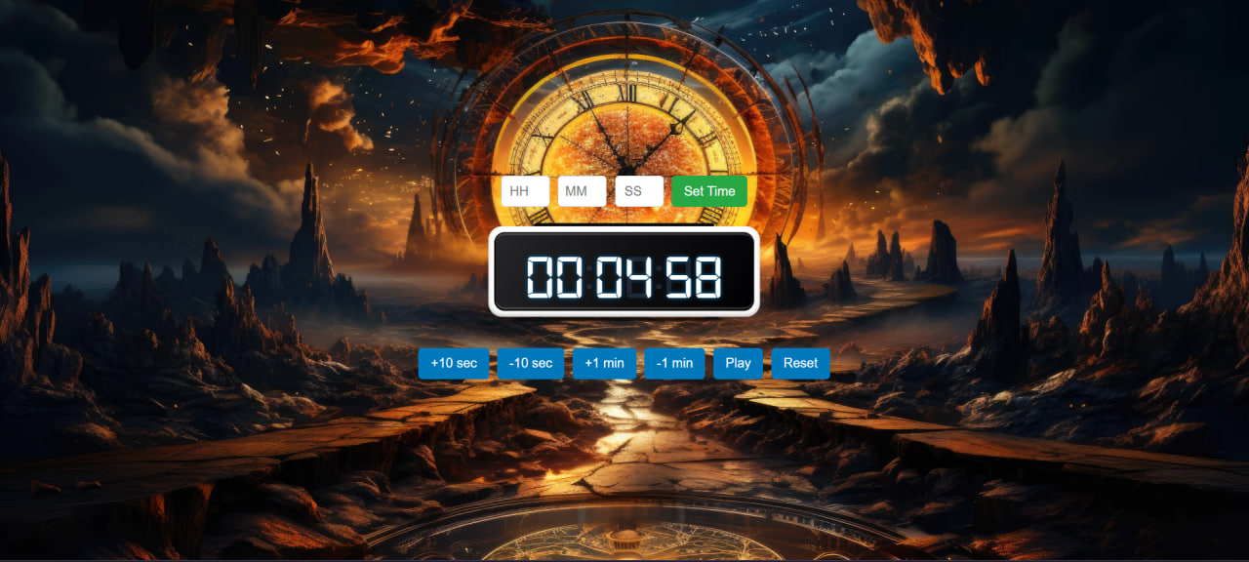
Better design decisions
Research has shown that users prefer simple and at the same time functional design, and recently dark mode has become more and more popular due to work at night. That's why I tried to choose a background in darker tones.

Slide 4




New ficures
Alarm sound
Pause option
Set exect time optinon

Slide 5

Thanks for your attention

